Slide 1
Climate change: “Insurance in times of climate Change”

Slide 2
INSURANCE IN TIMES OF CLIMATE CHANGE
AIDA EUROPE CONFERENCE
NOVEMBER 3-4 2016
VIENNA, AUSTRIA
BY
Richard K. Traub
Traub Lieberman Straus & Shrewsberry

Slide 3
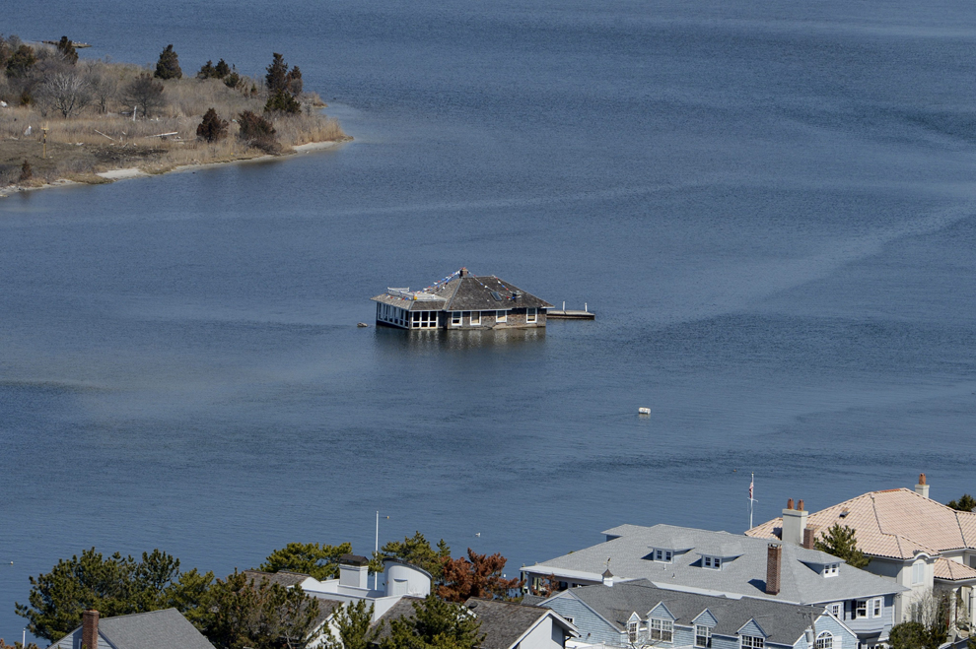
This is not a house boat

Slide 4
Does the Cause Matter? The Denialists
Global warming has little to do with global warming.
H.L. Menchen – “The whole aim of practical politics is to keep the populace alarmed – and hence clamorous to be led to safety – by menacing it with an endless series of hobgoblins, all of them imaginary.”
“The urge to save humanity is almost always only a false face for the urge to rule.”
“It doesn’t matter what is true, it only matters what people believe is true.” Paul Watson, founder of Greenpeace.
The threat to the world is not man-made global warming or climate change. It is, as is always the case, a current group of humans who want to impose their values and desires on others.
“We routinely wrote scare stories…Our press reports were more or less true…We are out to whip the public into a frenzy about the environment.” Jim Sibbison, former public relations official for the EPA.

Slide 5
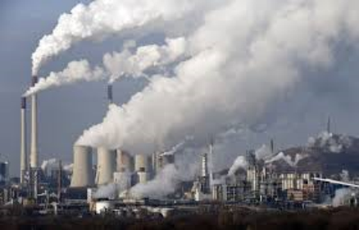
The Human Cause
Some have argued that there has been a pause in global warming.
NOAA – never stalled, just masked by incomplete data.
Temperature increase during the last half of the 20th century virtually identical to that of the 21st century.
Warming from 1998-2012 was more than double the previous estimates.
Humanity is the cause of earth getting hotter primarily by burning fossil fuels and deforestation.

Slide 6
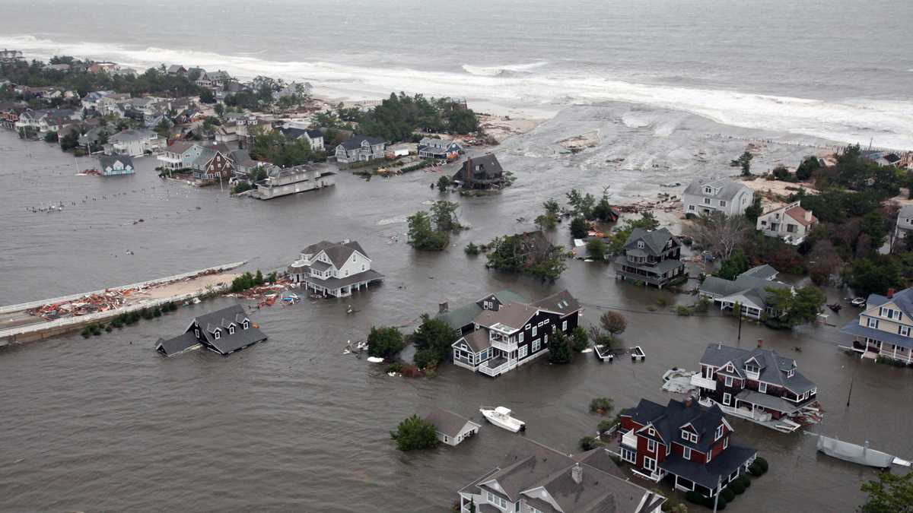
What Climate Change? Superstorm Sandy

Slide 7
The Oceans will Give us the Answer – Humankind or Random Events?
Warming of late 70’s correlates almost 1:1 with Pacific warming.
Cycle flipped in 1978. 30 year stretch now over and starting to cool.
Atlantic still in its warm cycle but will soon turn cold.
If the naturalists are right, the temperatures will cool. If they do not, those that say it is CO2 will be proven right.
Oceans of the planet have 1,000 times the heat capacity of the atmosphere. Thus if you warm the ocean, you warm the air.

Slide 8
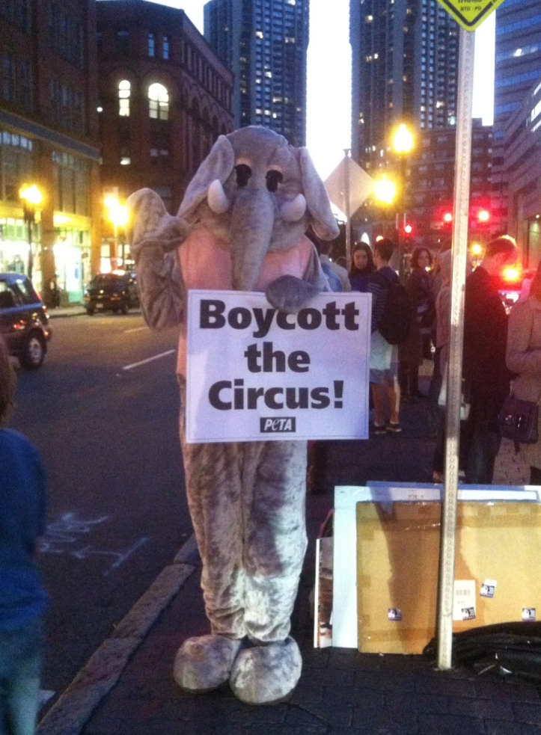
What Should be Done? 10 Suggestions
Limit power plan production.
Prioritize China’s pollution problem.
Expand carbon markets around the world.
Unleash clean energy in the US.
End fossil fuel subsidies.
Slow deforestation.
Stop methane leaks.
Cut deadly soot.
Phase our super polluting hydrofluorocarbons
(HFCs).
Reduce fertilizer production.

Slide 9
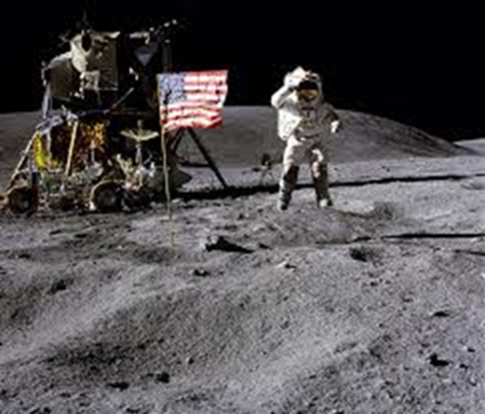
What The Question/Answer?
Not who is right or wrong!
Should we be spending time and treasure on something that will be proven by objective testing over the next few years?

Slide 10
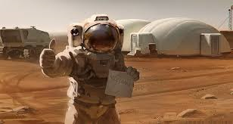
Why Not Let the Forecast Happen?
Will need the Apollo program to find another place to live.
Can’t we still improve air quality regardless?
What should the industry be doing and what is the liability for harms resulting from climate change?

Slide 11
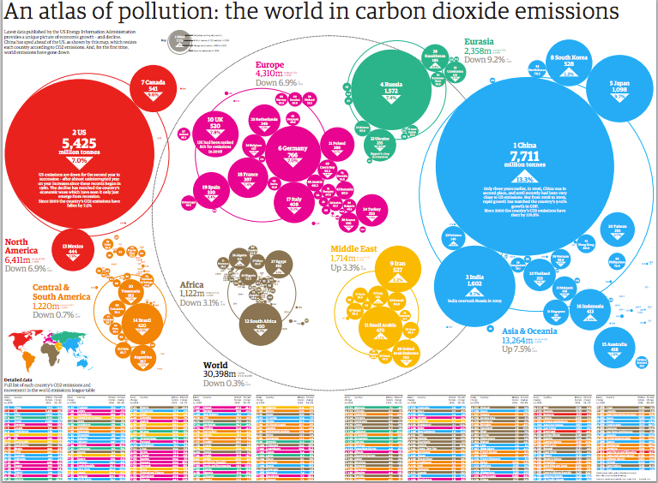
Liability for Climate Change
Standing and Political Question.
Judges barred from imposing their own limits on GHG emissions.
Clean Air Act supersedes and federal common law.
No common law claim of nuisance.

Slide 12
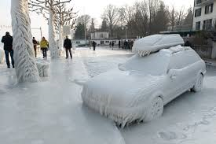
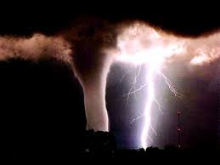
Insurance Coverage for Injury or Liability Associated with Climate Change
“Associated” not “Arising From.”
Severe or Extreme Weather Events.
Its Real and Will Lead to Increased $ for Covered Events.
No coverage for “resulting from” but there is for “associated” with climate change.
Wind, flood, freezing, heat, earth movement, collapse.

Slide 13
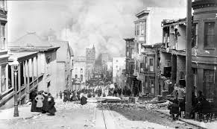
The Industry
Insurance industry is uniquely qualified to understand climate change and broaden society’s awareness of it and provide solutions.
Losses from extreme events to increase by as much as 40% by end of decade.
Bad year could exceed $1 Trillion.
Duty to society and to shareholders to minimize exposure.
Historically taken the lead in minimizing risk:
Building codes for fire and earthquakes.

Slide 14
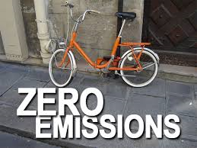
Loss Prevention Solutions
Energy Efficient Programs.
Green building designs.
Sustainable driving practices.
Carbon emission trading.
Financing mortgages for those with efficient homes or home upgrades.
Reduce their own GHG’s.

Slide 15
Industry is responding
Wind farms and other alternative fuels.
Emerging financial risks from carbon trading.
Protect those that invest in clean technology projects against failure to deliver agreed emission rates.
Carbon risk management consulting services.
Discounts on auto insurance for driving fewer miles.
Discounts for green building construction.
Coverage for loss of income for those that sell excess energy created from private sources.
Innovative insurance products that can become profit centers.

Slide 16
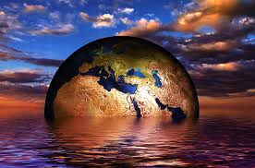
Last Thoughts
2016 on pace to be hottest ever on record.
More heatwaves, extreme rainfall, higher impact of tropical cyclones/hurricanes.
Arctic sea melted early and fast.
CO2 levels reached new highs.
June was 14th consecutive month of record heat for land and oceans.
378th consecutive month above 20th century average.
El Nino event of 2015 was one of the most powerful on record.
Temps in Coral Sea and Great Barrier Reef highest on record resulting in bleaching of the reef. Impacts lifetime of reefs.
Depending on where you are, you are either too wet or too dry.
Enough said.

